Slide 1
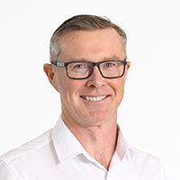
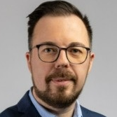
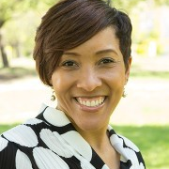
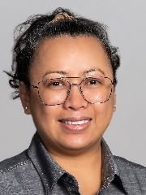
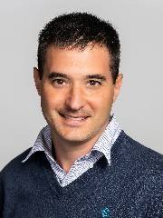
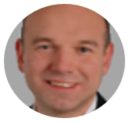
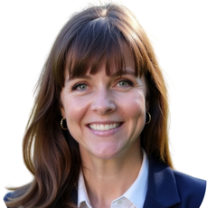
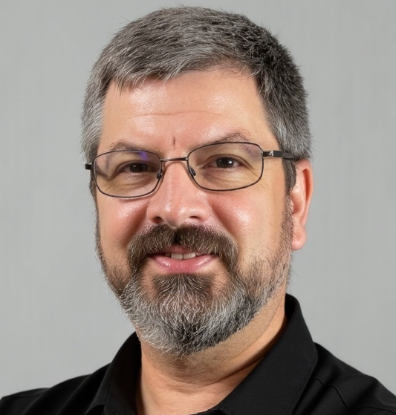
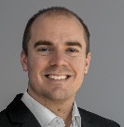
OFS Training & Development
Cathal (Cal) McGinley
GM, Global Training
Finance
Nemanja Kandic
HR
Danielle
Craig
EHS
Lizlee
Galley
Internal
Training
Leonardo Monzo
Customer
Training
Johann Daxer
Programs &
Competency
Michele Alcantar
Technical Training
Delivery
Jim Rosen
FE
Training & Development
Managers
Nimra Kazmi - EUR
EU FEPs (33)
Alyssa Mays - NAM
NAM EXEC FEPs (60)
Brenda Roman - NAM
NAM COE FEPs (53)
Paula Pedroza - LATAM
LATAM FEPs (13)
Howayda Sabry Maher - MEA
MEA FEPs (20)
Siaw Wei Tan - APAC
APAC FEPs (9)
Craft
Training & Development Managers
Carlo Fabregas – APAC
Mouna Boucherka – MEA
Erica Peredo – LATAM
Marcela Bohorquez – NAM
Beyza Yaver - EUR
Training Project Managers
Aboubaida El Mansoor – MEA
Pat Molumby – NAM
Anna Petrella - EUR
Alejandra Saldana - LATAM
Gavin Yoong - Asia
Maria Medina – Open Enrolment
Program Managers
Tamara Biediger
Ankita Gupta
Salim Messekine
Luca Martino
Julieta Ponce
Competency System
Managers
Kelly Kirby
Gloria Norris
Simulations
Aaron Hayes
Charles Wall
GAS TURBINE
Sherif Khalifa
Instructors
Salah Ahmed
Lemuel Armstrong
Selma Boutira
Steve Brasseaux
Jimmy Capps
Agustin Collado
Gary Franklin
Coy Jackson
Hichem Mesli
Tim Taylor
Nour Galal
Tom Walsh
Joel Maciejewski
Essam Ali
Humberto AranaSalas
Ihsan Allah Rakha
Mohamed Abdelaziz
Matt Wofford
Ahmed Yassin
GEN & ELEC EXC
Ben Smith
Instructors
Khaled Al Behiri
Zakaria Al-Qawasmeh
Willy Bueno
Joe MacAndrews
Julio Ramirez
Oscar Torres
Guy Zamor
Renan Lopes
Imran Arshad
CRAFT / OSS
Harry Hanson
Instructors
Lou Baez
Steven Conrad
Henry Gallagher
Paul Dugas
Helio Garcia
Tom Harbin
Roy Koenig
Bruno Lofaro
Doug Moon
Juan Palaez
Matt Remillard
Rainer Schumacher
Randall Stephenson
Joshua Cabler
Anthony Hall
Tom Samuelson
James Ledford
LA Osborn
ALSTOM & ST
Pablo Schibli
Instructors
Domingo Aleman
Aaron Curtis
Evgenii Deviatkov
Vito Franco
Donald Hopkins
Amin Houidi
Alek Kitanovic
Gaetan Kofmel
Santosh Kumar
Dave Miller
Jeff Ogletree
Mario Muñoz
Rene Rivas
Carlos Arevalo
Yeturi Raghunath
Rrahman Arslani
AERO
Greg Walker
Instructors
R. De Conceicao
Elias Benedi
Richard Fisher
Mark Girling
Douglas Salazar
John Selman
Tim Walker
Tamilarasan Kannaiyan
WORKFORCE READINESS / CTE
Linda Nelson
Instructors
Zed Anigwe
CONTROLS
Mohammed Nizami
Instructors
Carla Borbolla
Gerardo Gonzalez
Joshua Brand
John Doss
Yegor Spencer
Bharat Vispara
Martin Acosta
Muhammad Ahmed
Rafael Venancio
Doug Wadsworth
Isaiah Mason
Nasreddine Laroussi
Gopinath Kumar
Margaret Baluyut
Mahesh Vangaveeti
Training
Operations
Philip Ganssmann
OPS EXCELLENCE
Jennifer Wright
Direct Reports
Daniel Barrera
DELIVERY & LOGISTICS
Andrew Ruch
DESIGN & DEVELOPMENT
Lee Fielding
Technical Delivery
Support
Andrew Samples
Site Support
Chanelle Williams
Lida Shiri
Irving de La O
Diana Portes
Scheduling
Marisol Guidry
Nelsa Bernal
Sian La Borde
Iuliia Zgonnik
Rooftops
Stephen Urban - HLC
Mouna Boucherka - KLC
Learning Management Systems
Diana Torres
Instructional Content Designers
Laura Bettex
Konstantina Georga

